Slide 1
Basis Expansions and Generalized Additive Models (1)
Regression and shrinkage
Basis expansion
Piecewise polynomials

Slide 2
Model
Training data
Testing data
Model
Testing error rate
Training error rate
Good performance on testing data, which is independent from the training data, is most important for a model.
It serves as the basis in model selection.

Slide 3

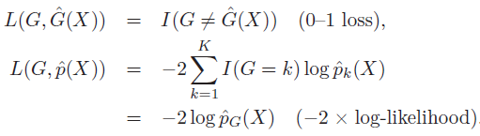
Test error
To evaluate prediction accuracy, loss functions are needed. Continuous Y:
In classification, categorical G (class label):
Where ，
Except in rare cases (e.g. 1 nearest neighbor), the trained classifier always gives a probabilistic outcome.

Slide 4


Test error
Test error: The expected loss over an INDEPENDENT test set. The expectation is taken with regard to everything that’s random - both the training set and the test set.
In practice it is more feasible to estimate the testing error given a training set:
Training error is the average
Loss over just the training set:

Slide 5
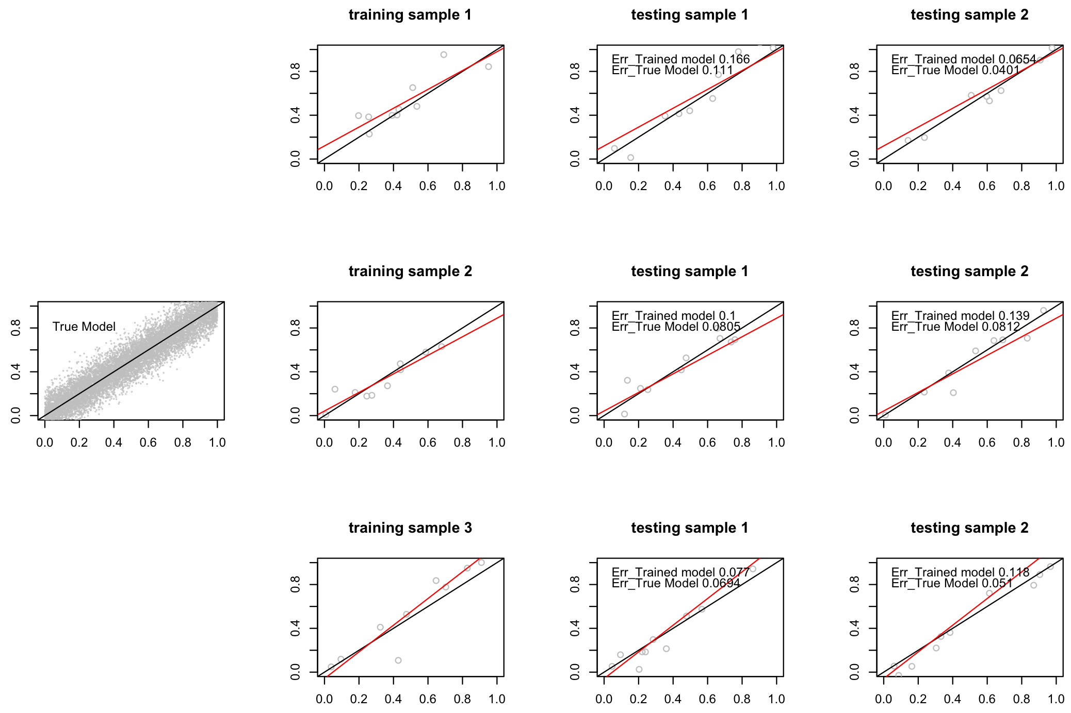
Test error

Slide 6
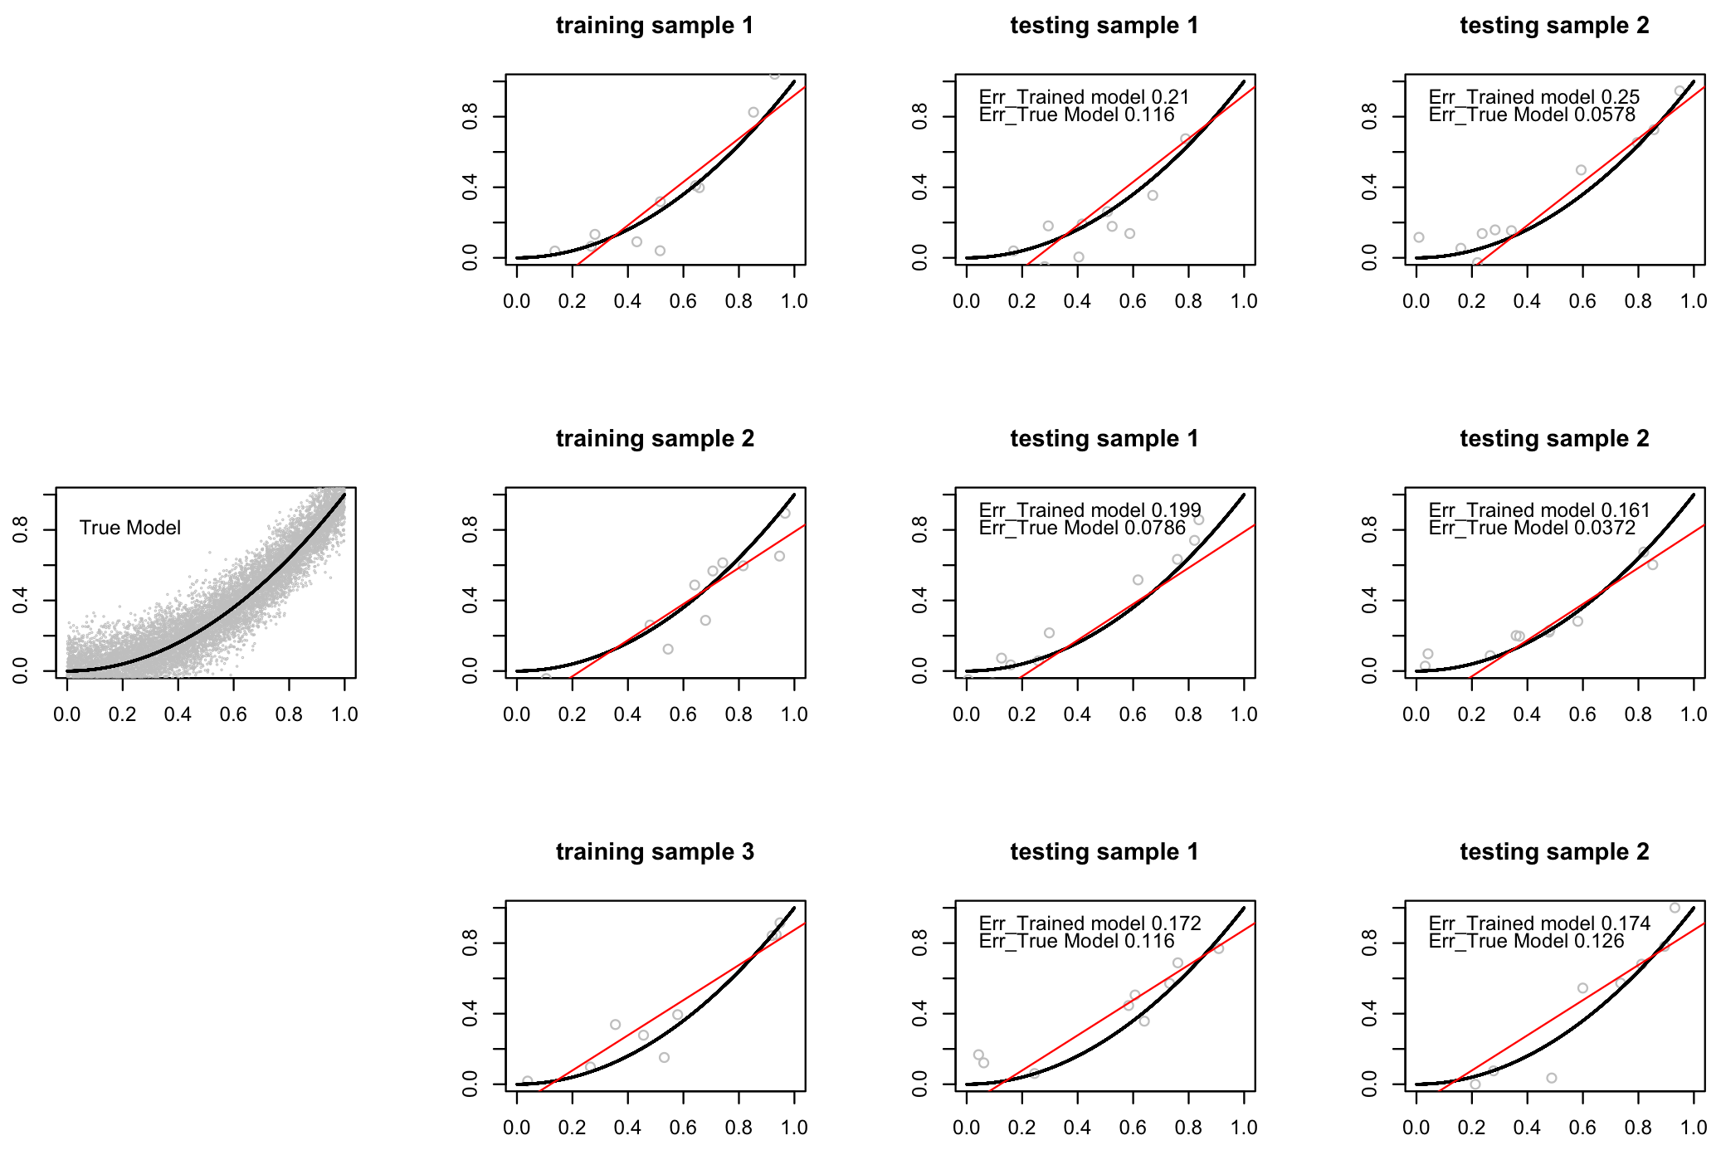
Test error

Slide 7
Goals in model building
Model selection:
Estimating the performance of different models; choose the best one
(2) Model assessment:
Estimate the prediction error of the chosen model on new data.

Slide 8

Goals in model building
Ideally, we’d like to have enough data to be divided into three sets:
Training set: to fit the models
Validation set: to estimate prediction error of models, for the purpose of model selection
Test set: to assess the generalization error of the final model
A typical split:

Slide 9
Goals in model building
What’s the difference between the validation set and the test set?
The validation set is used repeatedly on all models. The model selection can chase the randomness in this set. Our selection of the model is based on this set. In a sense, there is over-fitting in terms of this set, and the error rate is under-estimated.
The test set should be protected and used only once to obtain an unbiased error rate.

Slide 10
Goals in model building
In reality, there’s not enough data. How do people deal with the issue?
Eliminate validation set.
Draw validation set from training set.
Try to achieve generalization error and model selection. (AIC, BIC, cross-validation ……)
Sometimes, even omit the test set and final estimation of prediction error; publish the result and leave testing to later studies.

Slide 11



Bias-variance trade-off
In the continuous outcome case, assume
The expected prediction error in regression is:

Slide 12
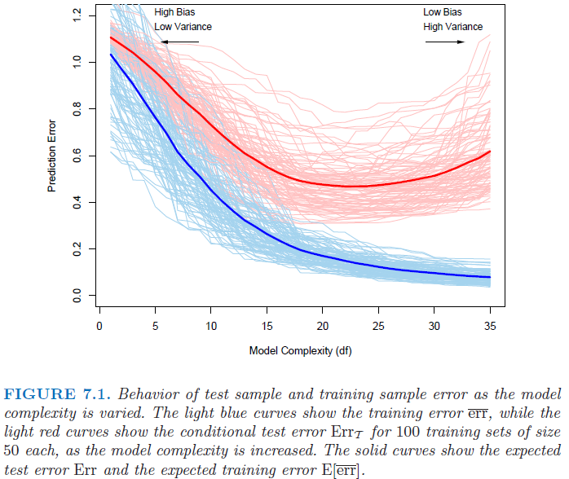
Bias-variance trade-off

Slide 13
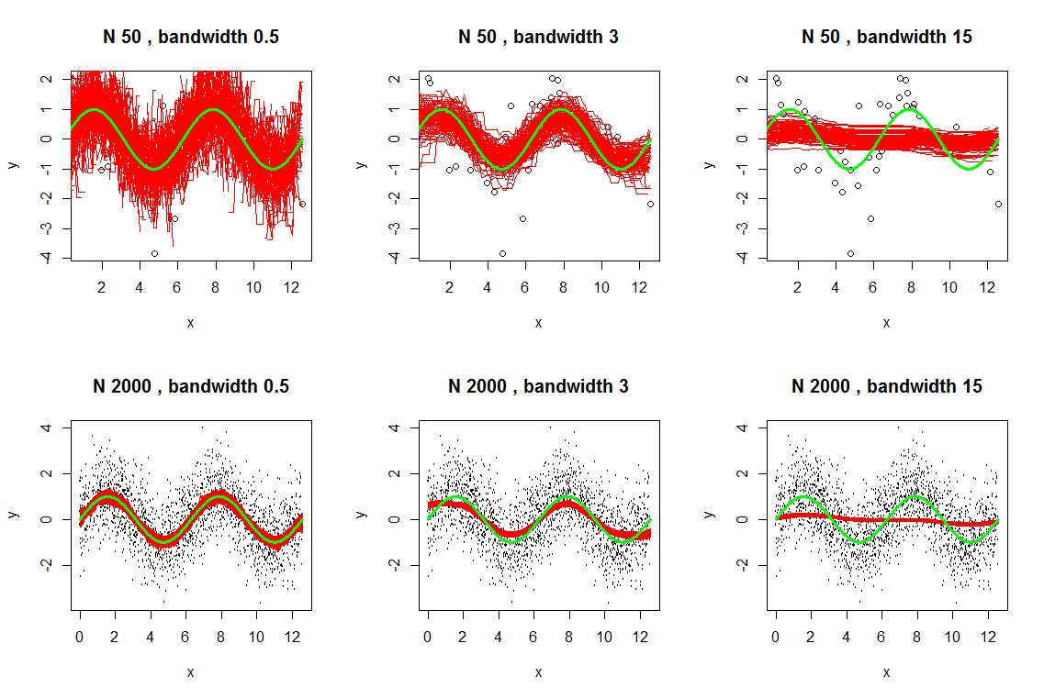
Bias-variance trade-off
Kernel smoother. Green curve-truth. Red curves – estimates based on random samples.

Slide 14
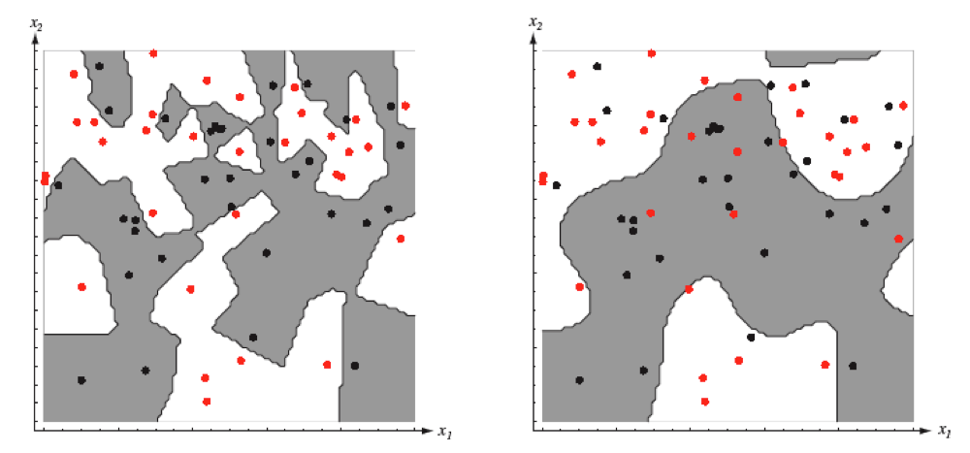
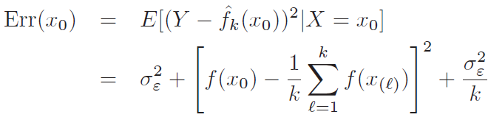
Bias-variance trade-off
K-nearest neighbor classifier:
The higher the k, the lower the model complexity (estimation becomes more global, space partitioned into larger patches)
Increase k, the variance term decreases, and the bias term increases. (Here x’s are assumed to be fixed; randomness only in y)
Bias

Slide 15
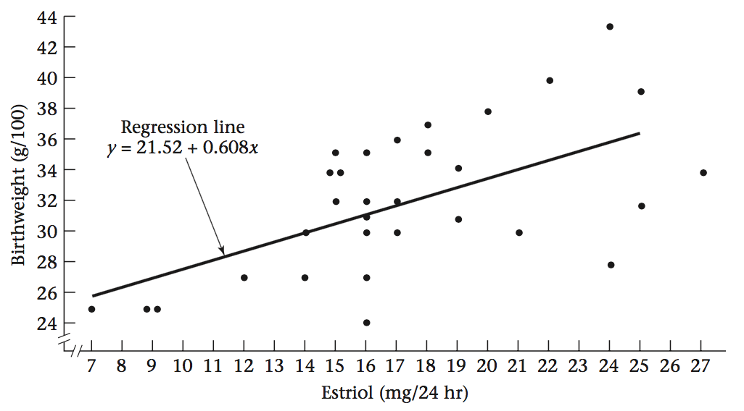
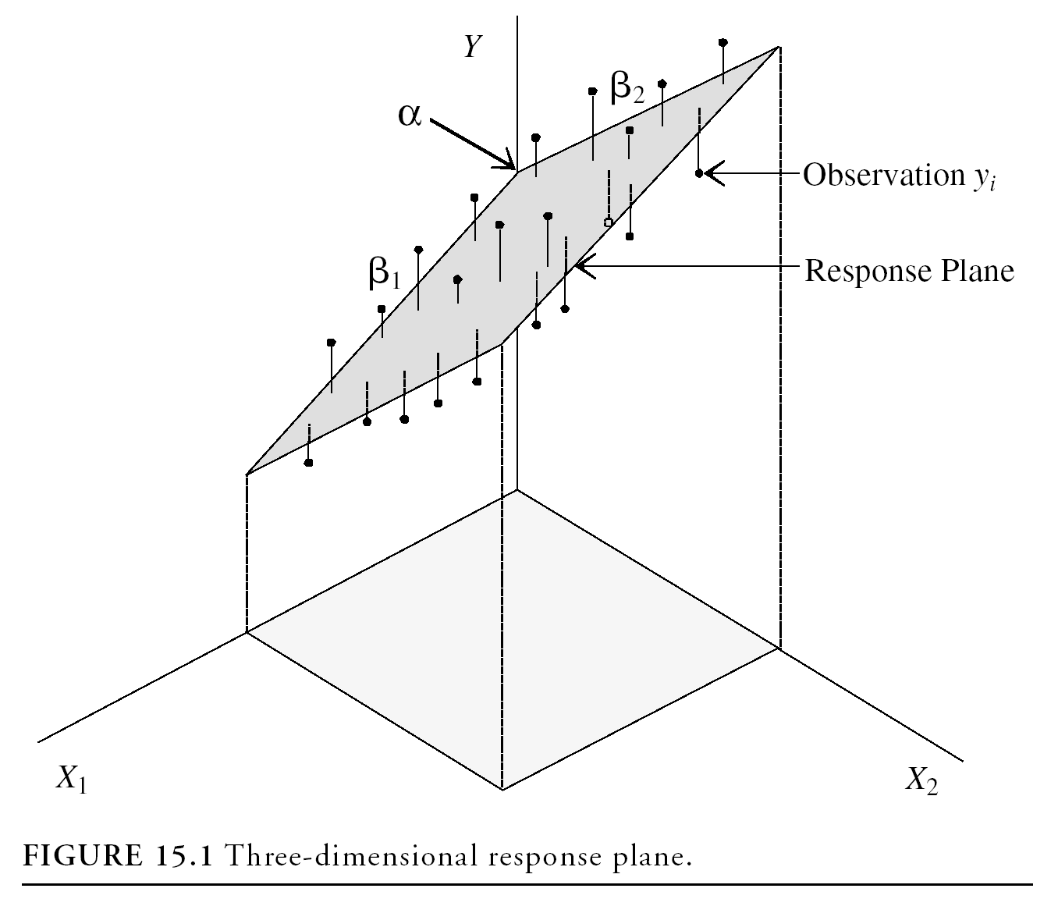
Linear regression
Simple linear regression:
E(y) = α+βx
α: intercept, β: slope
The fit is a line.
When there are multiple predictors:
E(y) = α+β₁x₁+β₂x₂+…+β_{k}x_{k}
The fit is a hyperplane.

Slide 16
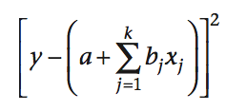
Loss function
y= α+β₁x₁+β₂x₂+…+β_{k}x_{k}+ε, ε~N(0, σ²)
The least square loss function:
The β_{j}, j = 1, 2,..., k are called “partial-regression coefficients”.
β_{j} represents the average increase in y per unit increase in x_{j}, with all other variables held constant.

Slide 17

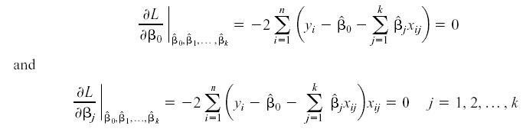
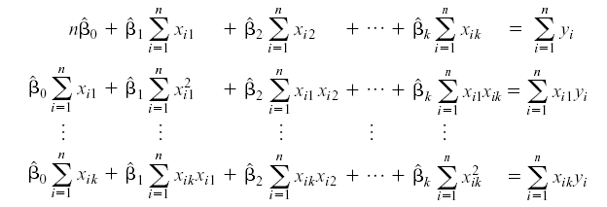

Loss function
Take partial derivative and set to zero:
Solve the set of linear equations:

Slide 18
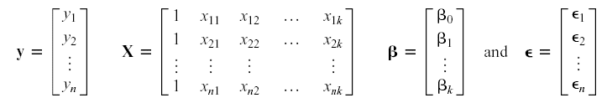


The Matrix approach
Loss function:
The solution:

Slide 19
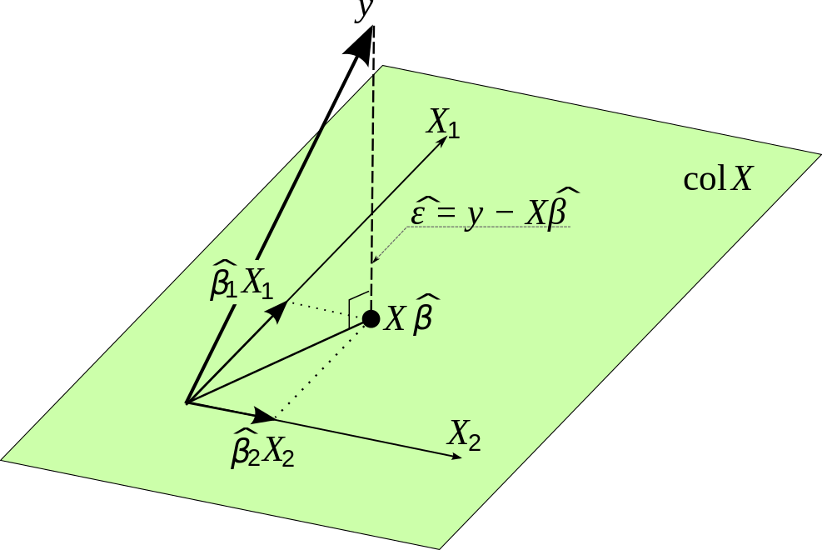
Geometric interpretation
https://commons.wikimedia.org/wiki/File:OLS_geometric_interpretation.svg

Slide 20

Shrinkage methods
The expected prediction error of a model contains variance and bias components, plus the irreducible error.
Under model:
Y=f(X)+ε

Slide 21
Shrinkage methods
Bias-variance trade off: by introducing a little bias into the model, we can sometimes reduce a lot of the variance, making the overall EPE much smaller.
Shrink the coefficient estimates towards zero
Shrinking the coefficient estimates can significantly reduce their variance (uncertainty), hence reduce prediction variance.
Irrelevant predictors are essentially removed by receiving 0 (or extremely small) coefficients.

Slide 22
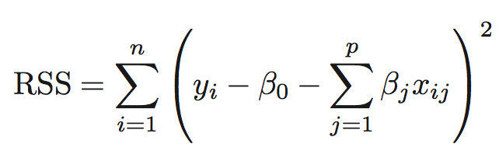
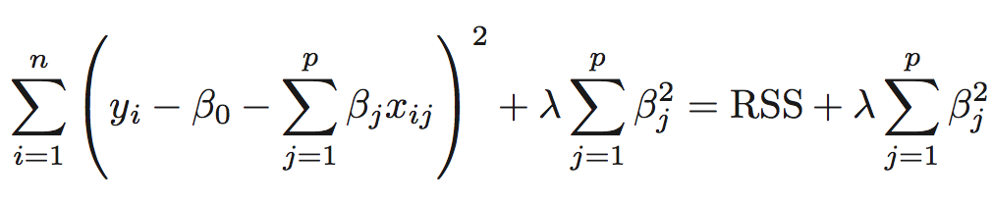

Shrinkage methods
Ridge regression:
In multivariate regression, we minimize the loss function:
In contrast, ridge regression loss function:

Slide 23
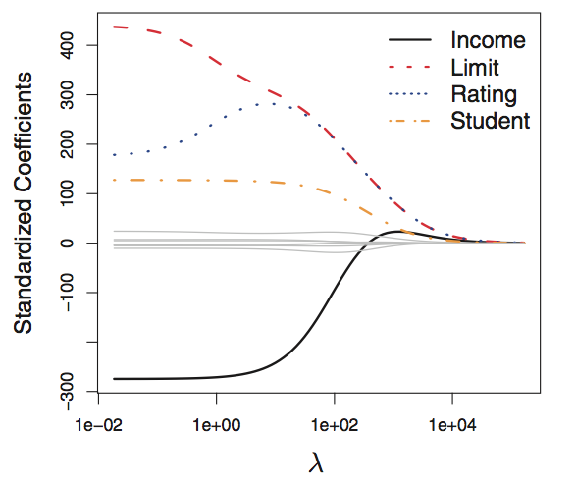
Shrinkage methods
It is best to apply ridge regression after standardizing the predictors
λ=0, least squares regression
λ large, ridge regression coefficient estimates will approach zero

Slide 24
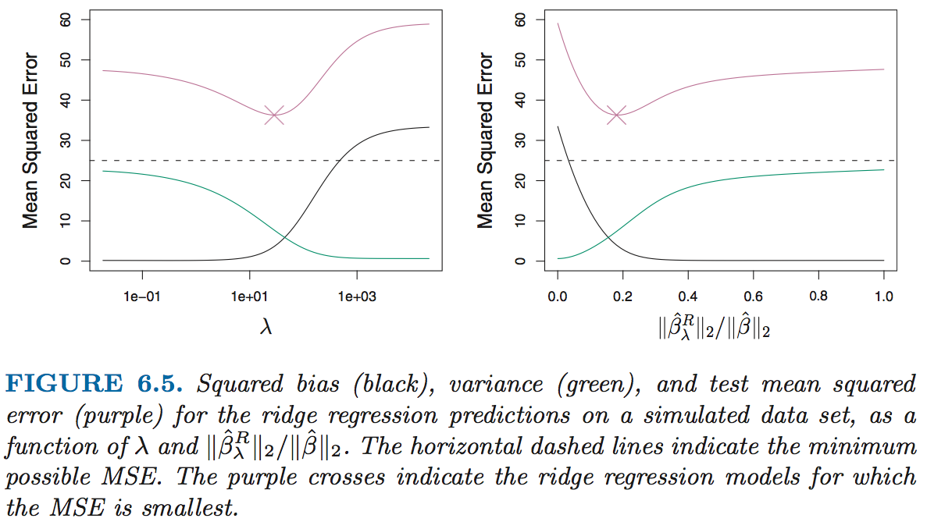
Shrinkage methods

Slide 25
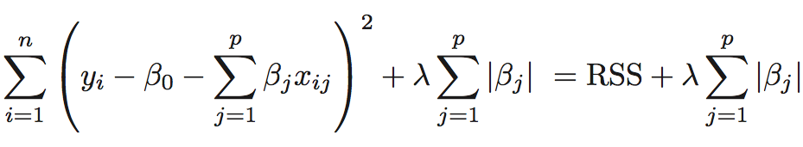
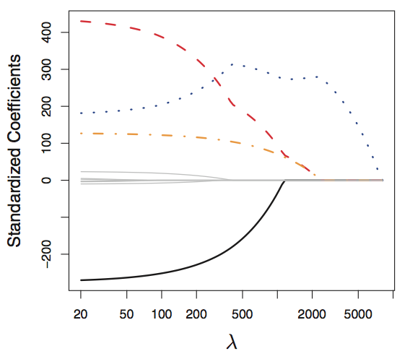
Shrinkage methods
Lasso.
The loss function:
The l₁ penalty has the effect of forcing some of the coefficient estimates to be exactly zero when the tuning parameter λ is sufficiently large.

Slide 26
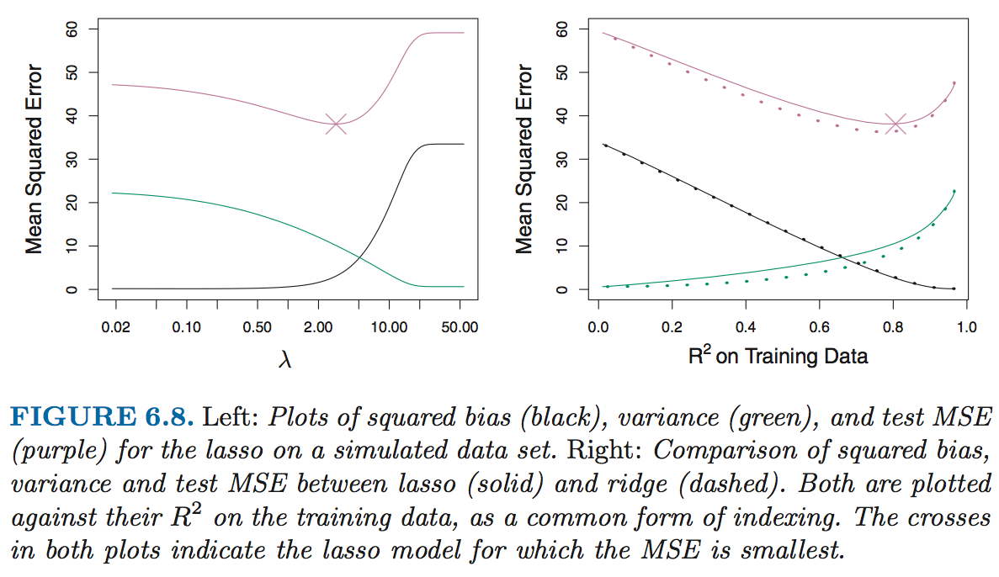
Shrinkage methods

Slide 27
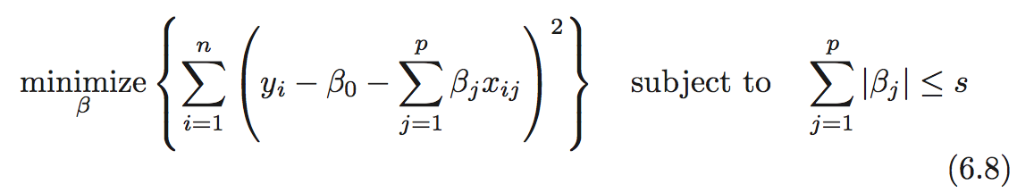
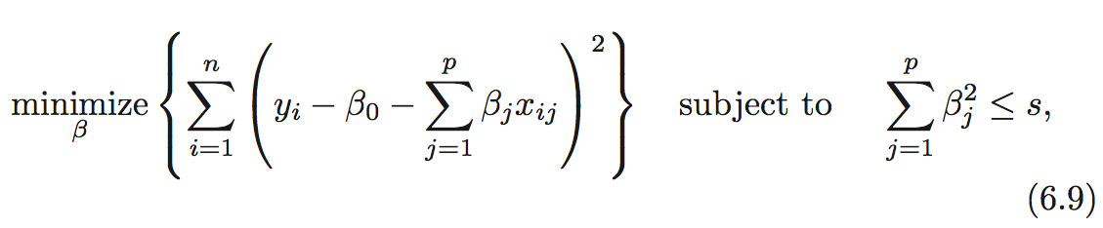
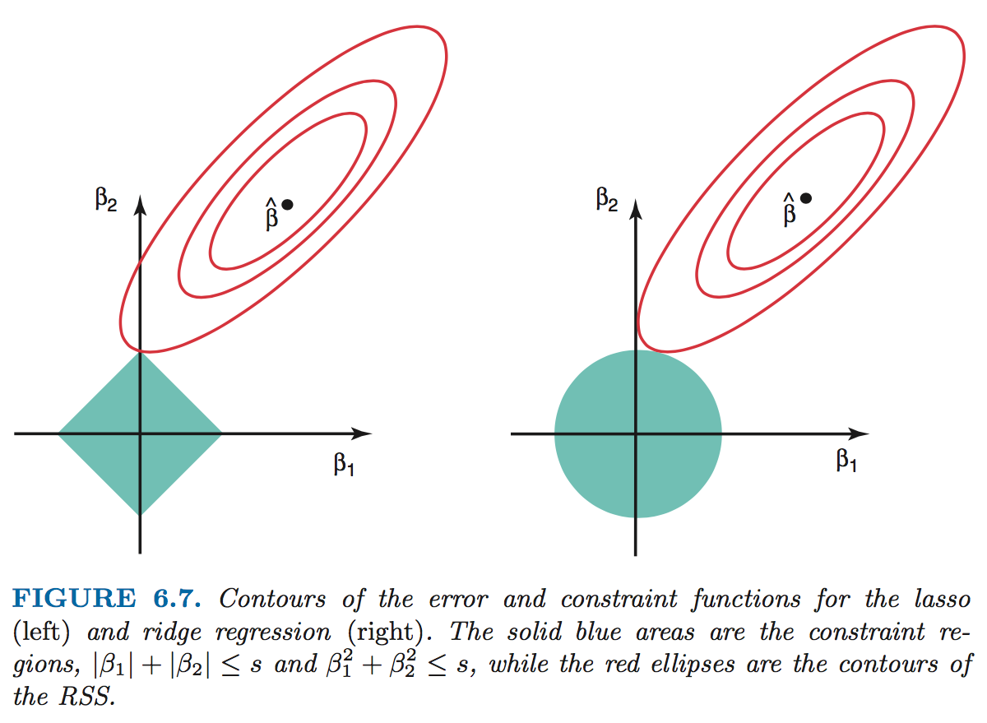
Shrinkage methods
Lasso:
Ridge:

Slide 28
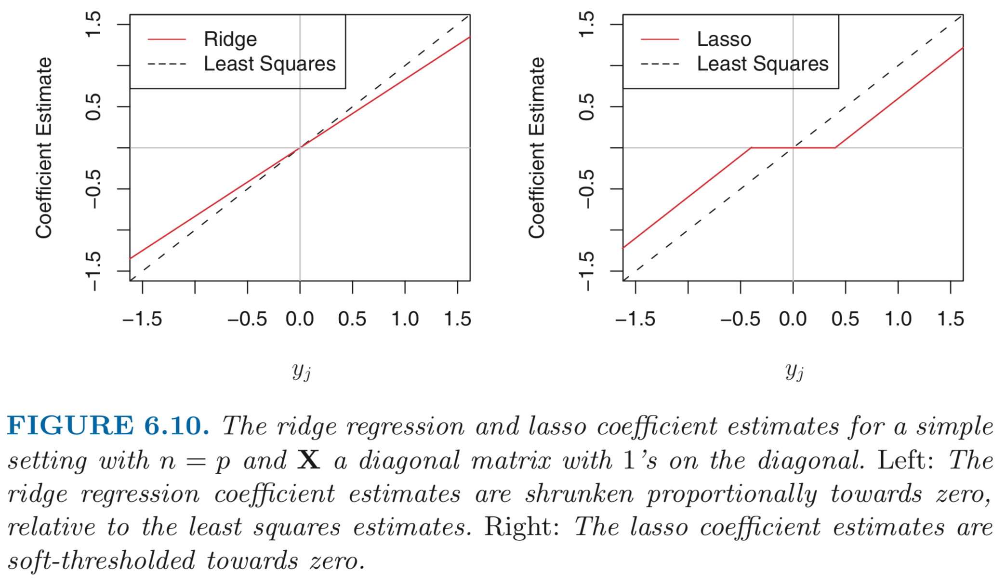
Shrinkage methods

Slide 29
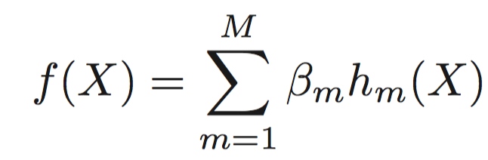
Basis expansion
f(X) = E(Y |X) can often be nonlinear and non-additive in X
However, linear models are easy to fit and interpret
By augmenting the data, we may construct linear models to achieve non-linear regression/classification.

Slide 30
Basis expansion
Some widely used transformations:
h_{m}(X) = X_{m}, m = 1, . . . , p → the original linear model.
h_{m}(X) = X_{j}², h_{m}(X) = X_{j}X_{k} or higher order polynomials → augment the inputs with polynomial terms
the number of variables grows exponentially in the degree of the polynomial: O(p^{d}) for a degree-d polynomial
h_{m}(X) = log(X_{j}), ... → other nonlinear transformations
h_{m}(X) = I(L_{m} ≤ X_{k} < U_{m}), breaking the range of X_{k} up into non-overlapping regions → piecewise constant

Slide 31
Basis expansion
More often, we use the basis expansions as a device to achieve more flexible representations for f(X)
Polynomials are global – tweaking functional forms to suite a region causes the function to flap about madly in remote regions.
Red: 6 degree polynomial
Blue: 7 degree polynomial

Slide 32
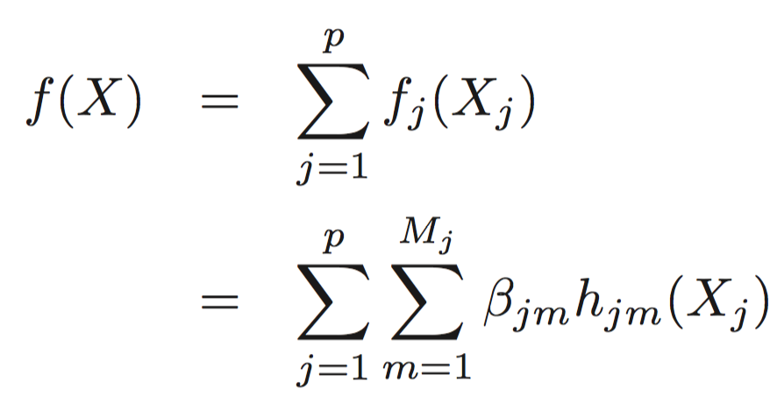
Basis expansion
Piecewise-polynomials and splines allow for local polynomial representations
Problem: the number of basis functions can grow too large to fit using limited data.
Solution:
Restriction methods - limit the class of functions
Example: additive model

Slide 33
Basis expansion
Selection methods
Allow large numbers of basis functions, adaptively scan the dictionary and include only those basis functions h_{m}() that contribute significantly to the fit of the model.
Example: multivariate adaptive regression splines (MARS)
Regularization methods where we use the entire dictionary but restrict the coefficients.
Example: Ridge regression
Lasso (both regularization and selection)

Slide 34
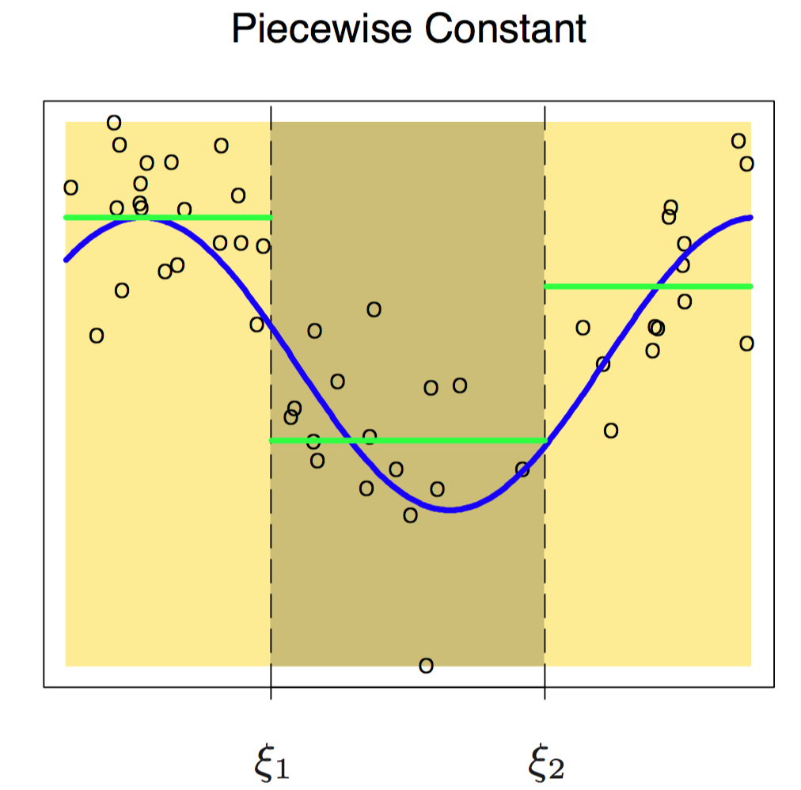
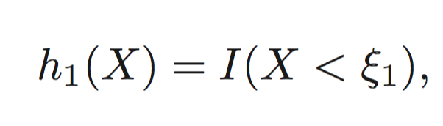
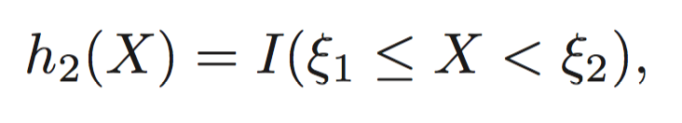
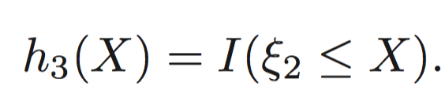


Piecewise Polynomials
Assume X is one-dimensional.
Divide the domain of X into contiguous intervals, and represent f(X) by a separate polynomial in each interval.
Simplest – piecewise constant

Slide 35
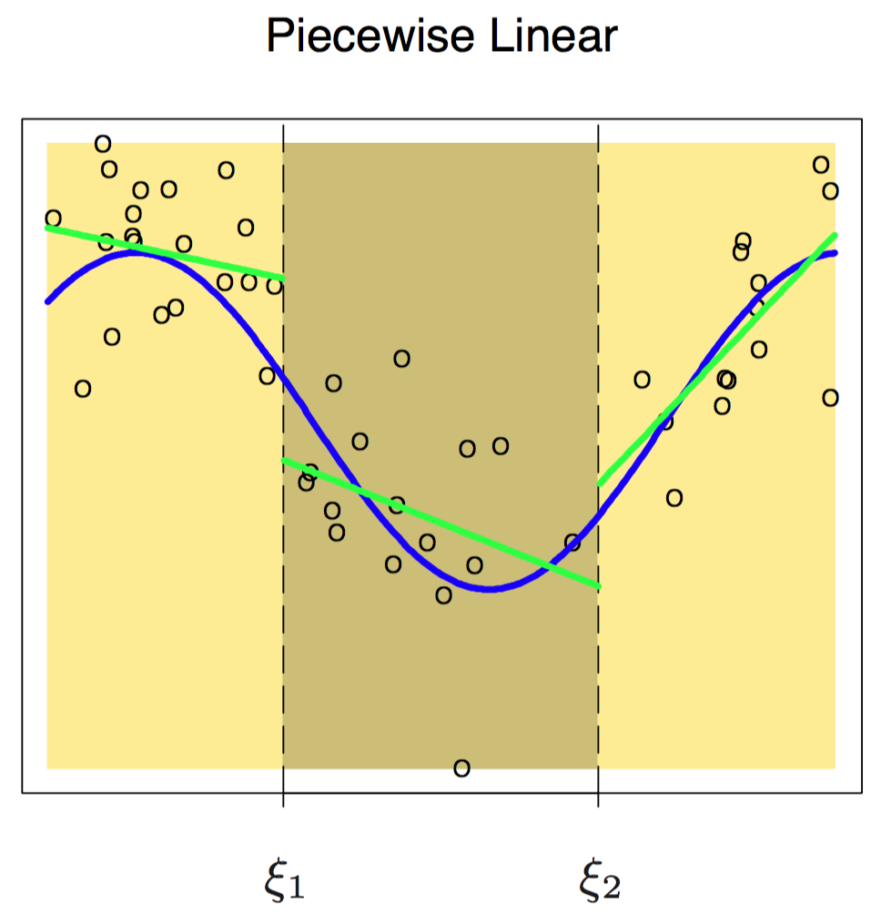
Piecewise Polynomials
piecewise linear
Three additional basis functions are needed:

Slide 36
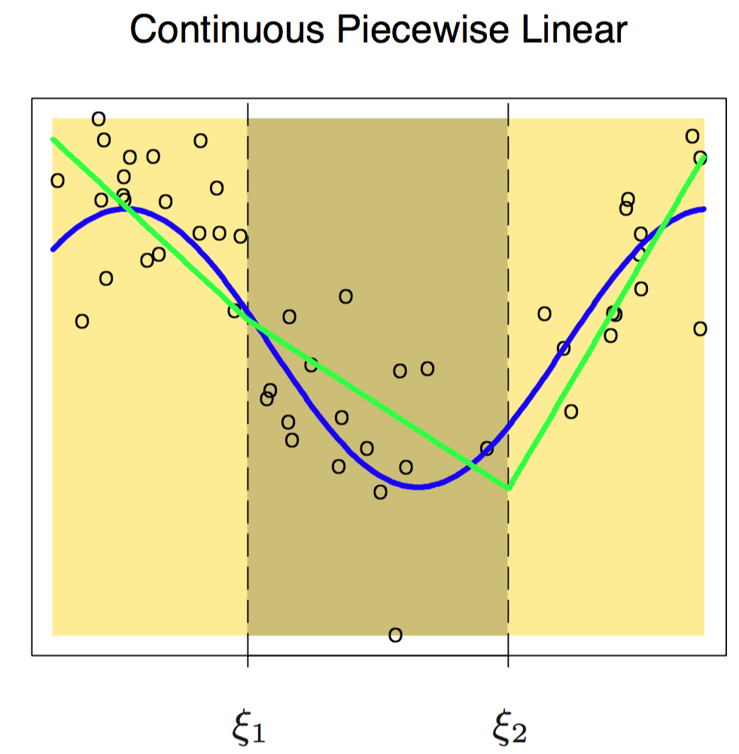
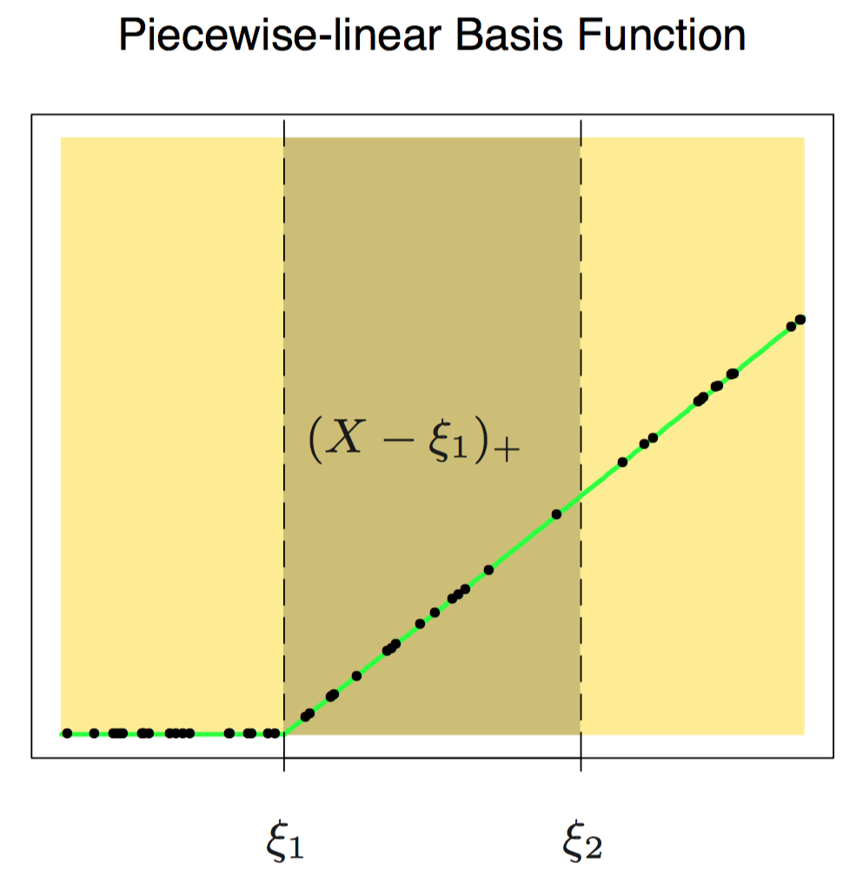
Piecewise Polynomials
piecewise linear requiring continuity

Slide 37
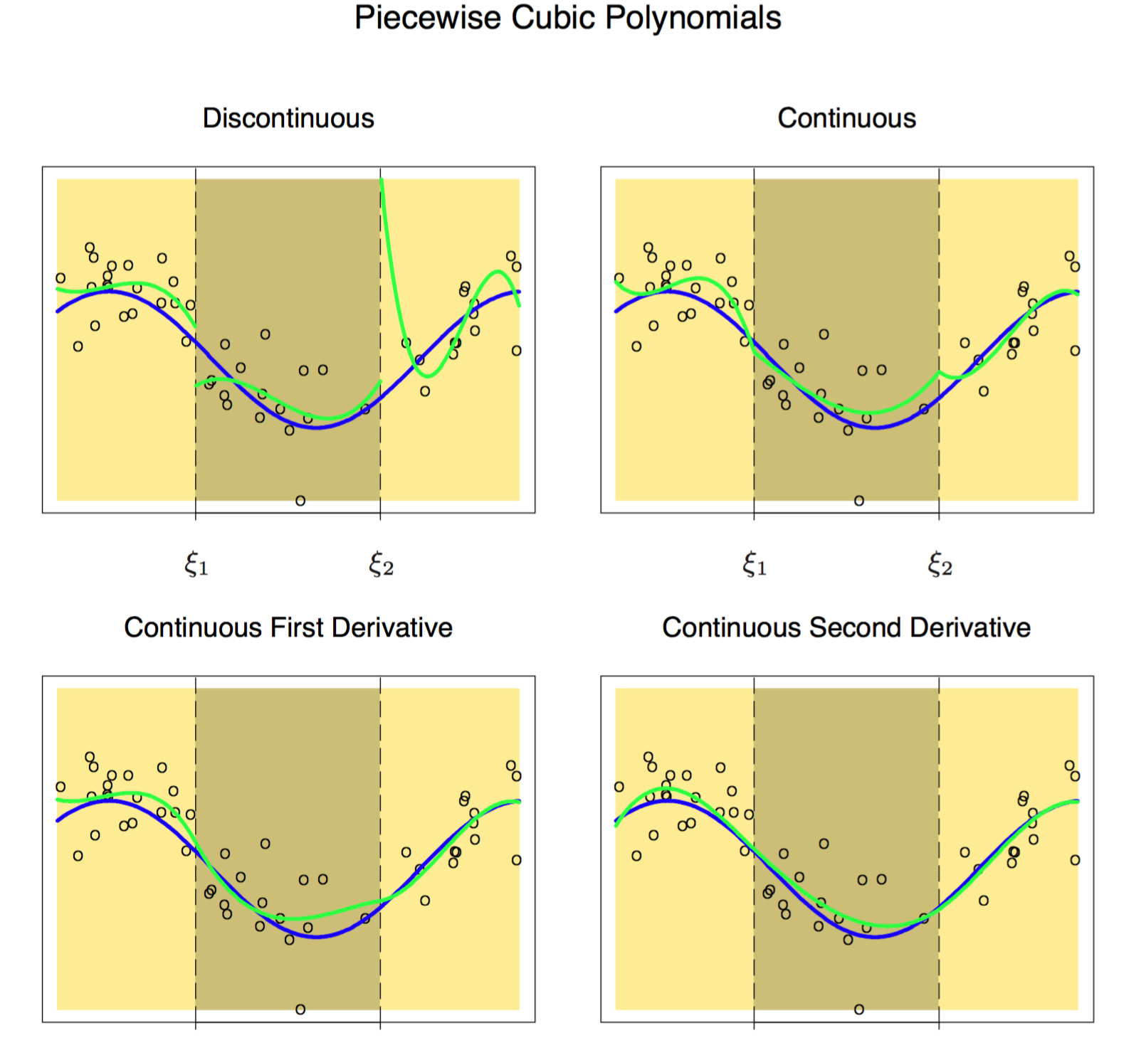
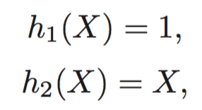
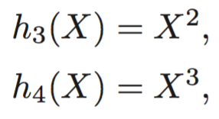
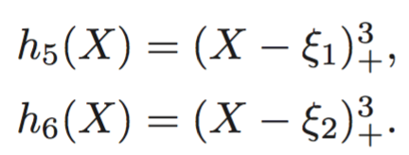
Piecewise Polynomials
Lower-right:
Cubic spline

